Slide 1
Megaminx

Slide 2
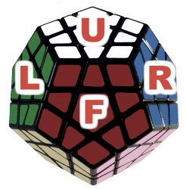
Allowed Moves
Up
Right
Front
Left

Slide 3
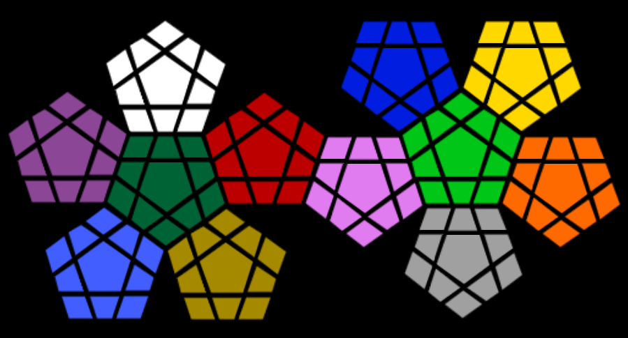
Numeration Method
1) Core
2) Down
3) Clockwise
G5
G6
G7
G4
G8
G0
G3
G9
G2
G10
G1

Slide 4


Numeration Method
G: Green
W: White
Pr: Purple
T: Turquoise
H: Honey
R: Red
L: Lime Green
Gr: Grey
O: Orange
Y: Yellow
B: Blue
Pi: Pink
W6
B5
B6
B7
Y5
Y6
Y7
W5
W7
B4
B8
Y4
Y8
W4
W8
B0
Y0
W0
B3
B9
Y3
Y9
Pr6
W3
W9
B2
B10
Y2
Y10
R6
L6
Y1
Pr5
Pr7
W2
W1
W10
R5
R7
B1
L5
L7
Pr4
Pr8
G5
R4
R8
L4
L8
O5
Pr0
G6
G7
R0
Pi5
Pi6
Pi7
L0
O6
O7
Pr3
Pr9
G4
G8
R3
R9
P4
Pi8
L3
L9
O4
O8
Pr2
Pr1
Pr10
G0
R2
R1
R10
Pi0
L2
L1
L10
O0
G3
G9
Pi3
Pi9
O3
O9
T6
G2
G10
H6
Pi2
Pi10
Gr5
Gr6
Gr7
O2
O10
T5
T7
G1
H5
Pi1
O1
T4
H7
Gr4
Gr0
Gr8
T8
H4
H8
T0
H0
Gr3
Gr9
T3
T9
H3
H9
Gr2
Gr10
T2
T1
T10
H2
H1
H10
Gr1

Slide 5
Basic Moves
Moves\Environment | Online Megaminx Simulator | Our Prolog Code
White - clockwise | 2 | u+
White - anticlockwise | 2‘ | u-
Blue - clockwise | 11 | r+
Blue - anticlockwise | 11‘ | r-
Red - clockwise | 6 | f+
Red - anticlockwise | 6‘ | f-
Green - clockwise | 1 (one) | l+ (L small-letter)
Green - anticlockwise | 1‘ | l-

Slide 6
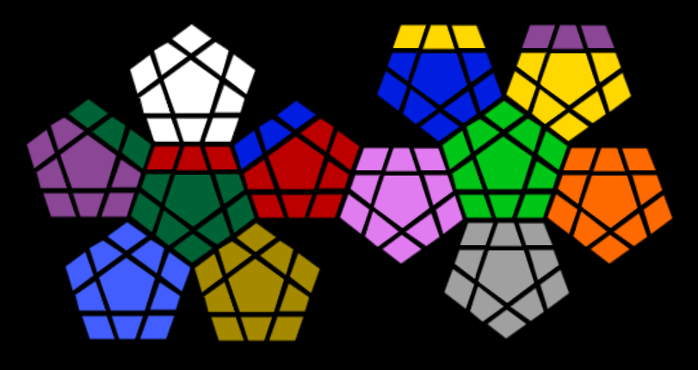
Basic MOVES
Prolog: u+
Online Simulator: 2
W6
Y5
Y6
Y7
Pr6
Pr7
Pr8
W5
W7
B4
B8
Y4
Y8
W4
W8
B0
Y0
W0
B3
B9
Y3
Y9
W3
W9
B2
B10
Y2
Y10
G5
B7
L6
Y1
Pr5
G6
W2
W1
W10
B6
R7
B1
L5
L7
Pr4
G7
R4
R5
R6
B5
R8
L4
L8
O5
Pr0
R0
Pi5
Pi6
Pi7
L0
O6
O7
Pr3
Pr9
G4
G8
R3
R9
P4
Pi8
L3
L9
O4
O8
Pr2
Pr1
Pr10
G0
R2
R1
R10
Pi0
L2
L1
L10
O0
G3
G9
Pi3
Pi9
O3
O9
T6
G2
G10
H6
Pi2
Pi10
Gr5
Gr6
Gr7
O2
O10
T5
T7
G1
H5
Pi1
O1
T4
H7
Gr4
Gr0
Gr8
T8
H4
H8
T0
H0
Gr3
Gr9
T3
T9
H3
H9
Gr2
Gr10
T2
T1
T10
H2
H1
H10
Gr1

Slide 7
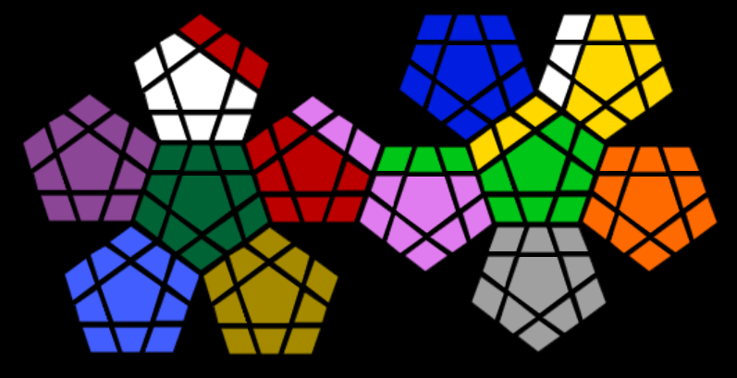
Basic MOVES
Prolog: r+
Online Simulator: 11
R6
B5
B6
B7
W8
Y6
Y7
W5
R7
B4
B8
W7
Y8
W4
R8
B0
Y0
W0
B3
B9
W6
Y9
Pr6
W3
W9
Pi5
B2
B10
Y2
Y10
Y5
Y1
Pr5
Pr7
W2
W1
W10
R5
Pi6
B1
Y4
L7
Pr4
Pr8
G5
R4
Pi7
L4
Y3
L8
O5
Pr0
G6
G7
R0
L5
L6
L0
O6
O7
Pr3
Pr9
G4
G8
R3
R9
P4
Pi8
L3
L9
O4
O8
Pr2
Pr1
Pr10
G0
R2
R1
R10
Pi0
L2
L1
L10
O0
G3
G9
Pi3
Pi9
O3
O9
T6
G2
G10
H6
Pi2
Pi10
Gr5
Gr6
Gr7
O2
O10
T5
T7
G1
H5
Pi1
O1
T4
H7
Gr4
Gr0
Gr8
T8
H4
H8
T0
H0
Gr3
Gr9
T3
T9
H3
H9
Gr2
Gr10
T2
T1
T10
H2
H1
H10
Gr1

Slide 8
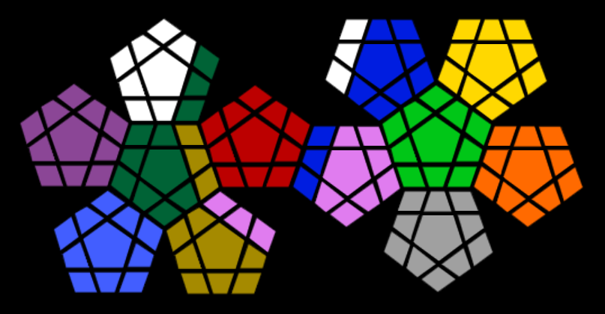
Basic MOVES
Prolog: f+
Online Simulator: 6
W6
W10
B6
B7
Y5
Y6
Y7
W5
W7
W9
B8
Y4
Y8
W4
G7
B0
Y0
W0
W8
B9
Y3
Y9
Pr6
W3
G8
B2
B10
Y2
Y10
R6
L6
Y1
Pr5
Pr7
W2
W1
G9
R5
R7
B1
L5
L7
Pr4
Pr8
G5
H6
R4
R8
L4
L8
O5
Pr0
G6
R0
B5
Pi6
Pi7
L0
O6
O7
Pr3
Pr9
G4
H7
R3
R9
B4
Pi8
L3
L9
O4
O8
Pr2
Pr1
Pr10
G0
R2
R1
R10
Pi0
L2
L1
L10
O0
G3
H8
B3
Pi9
O3
O9
T6
G2
G10
Pi3
Pi2
Pi10
Gr5
Gr6
Gr7
O2
O10
T5
T7
G1
H5
P4
Pi1
O1
T4
Pi5
Gr4
Gr0
Gr8
T8
H4
T0
H0
Gr3
Gr9
T3
T9
H3
H9
Gr2
Gr10
T2
T1
T10
H2
H1
H10
Gr1

Slide 9
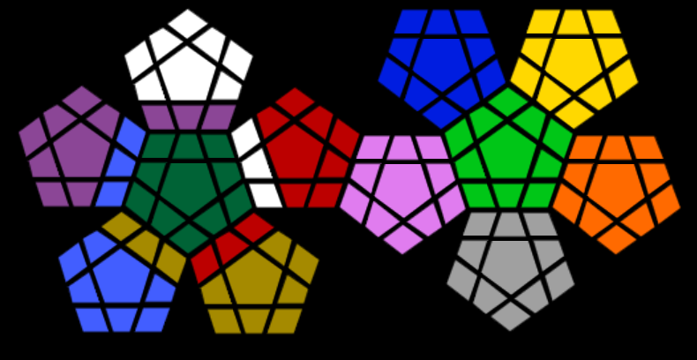
Basic MOVES
Prolog: l+ (L small-letter)
Online Simulator: 1 (one)
W6
B5
B6
B7
Y5
Y6
Y7
W5
W7
B4
B8
Y4
Y8
W4
W8
B0
Y0
W0
B3
B9
Y3
Y9
Pr6
W3
W9
B2
B10
Y2
Y10
R6
L6
Y1
Pr5
Pr7
Pr10
Pr9
Pr8
R5
R7
B1
L5
L7
Pr4
T6
G5
W2
R8
L4
L8
O5
Pr0
G6
G7
R0
Pi5
Pi6
Pi7
L0
O6
O7
Pr3
T7
G4
G8
W1
R9
P4
Pi8
L3
L9
O4
O8
Pr2
Pr1
T8
G0
R1
R10
Pi0
L2
L1
L10
O0
G3
G9
W10
Pi3
Pi9
O3
O9
H4
G2
G10
R4
Pi2
Pi10
Gr5
Gr6
Gr7
O2
O10
T5
H5
G1
R3
Pi1
O1
T4
R2
H7
Gr4
Gr0
Gr8
H6
H8
T0
H0
Gr3
Gr9
T3
T9
H3
H9
Gr2
Gr10
T2
T1
T10
H2
H1
H10
Gr1

Slide 10

Backup Slide - anticlockwise
W6
B7
B6
B5
Y7
Y6
Y5
Backup
W7
W5
B8
B4
Y8
Y4
W8
W4
B0
Y0
W0
B9
B3
Y9
Y3
Pr6
W9
W3
B10
B2
Y10
Y2
R6
L6
Y1
Pr7
Pr5
W10
W1
W2
R7
R5
B1
L7
L5
Pr8
Pr4
G7
R8
R4
L8
L4
O7
Pr0
G6
G5
R0
Pi7
Pi6
Pi5
L0
O6
O5
Pr9
Pr3
G8
G4
R9
R3
P8
Pi4
L9
L3
O8
O4
Pr10
Pr1
Pr2
G0
R10
R1
R2
Pi0
L10
L1
L2
O0
G9
G3
Pi9
Pi3
O9
O3
T6
G10
G2
H6
Pi10
Pi2
Gr7
Gr6
Gr5
O10
O2
T7
T5
G1
H7
Pi1
O1
T8
H5
Gr8
Gr0
Gr4
T4
H8
H4
T0
H0
Gr9
Gr3
T9
T3
H9
H3
Gr10
Gr2
T10
T1
T2
H10
H1
H2
Gr1

